Slide 1
Oracle 11g Forms & Reports Installation

Slide 2
Oracle Forms & Reports Builder 11g
You Must Install (Weblogic 10.3.6) Before Installing Forms & Reports Builder 11g

Slide 3
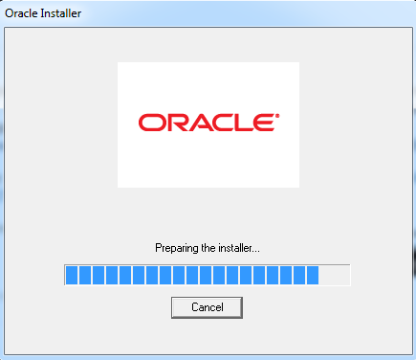
Weblogic 10.3.6
Run the executable file

Slide 4
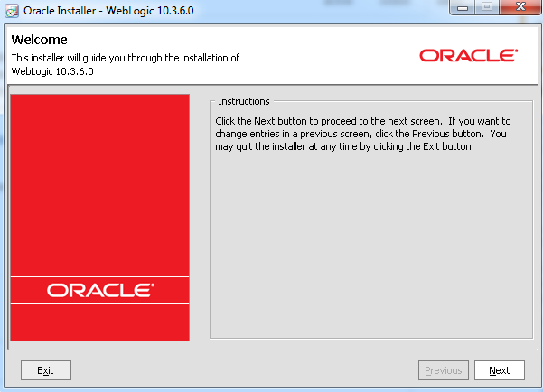
Weblogic 10.3.6

Slide 5
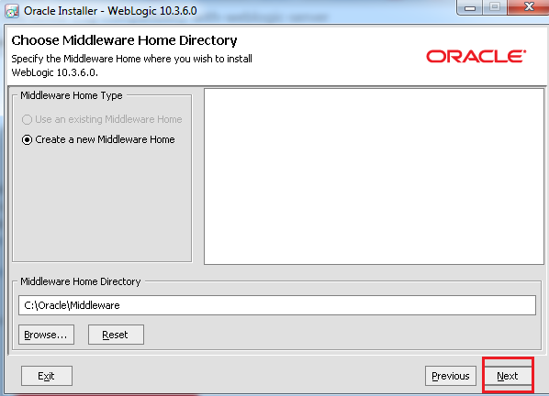
Weblogic 10.3.6

Slide 6
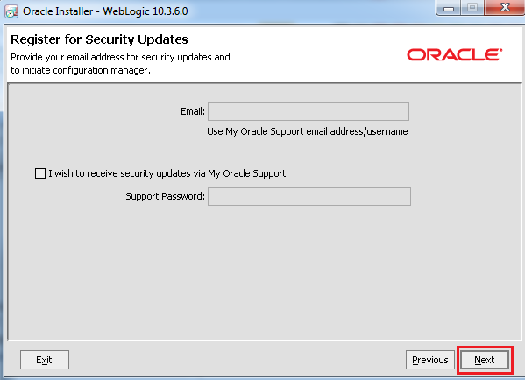
Weblogic 10.3.6

Slide 7
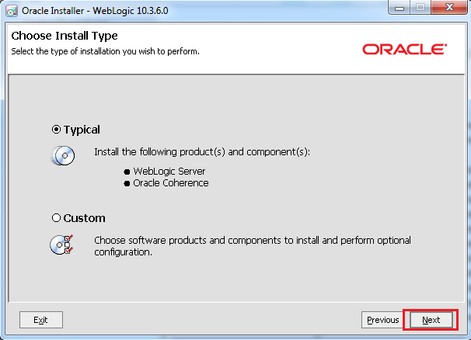
Weblogic 10.3.6

Slide 8
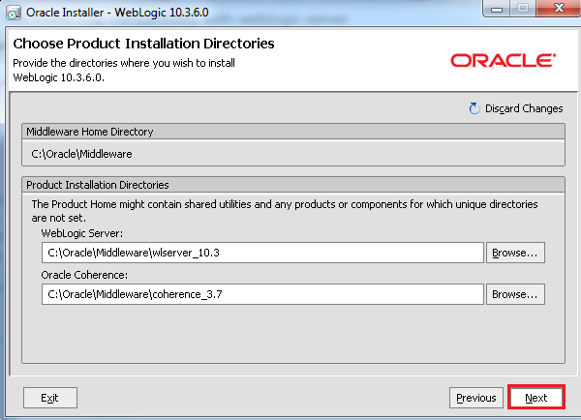
Weblogic 10.3.6

Slide 9
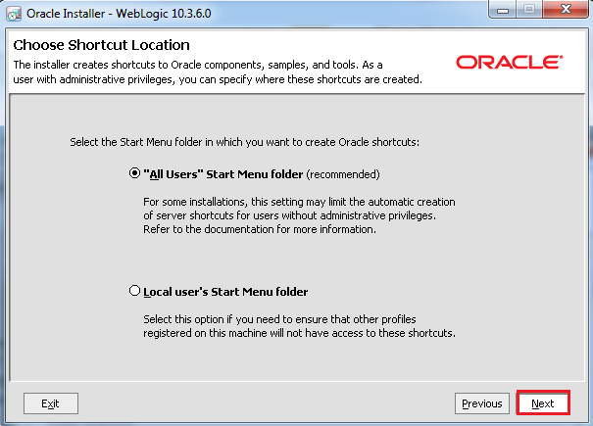
Weblogic 10.3.6

Slide 10
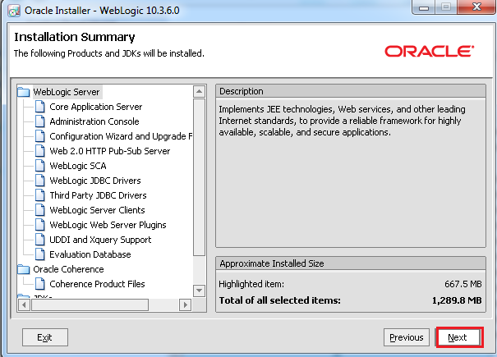
Weblogic 10.3.6

Slide 11
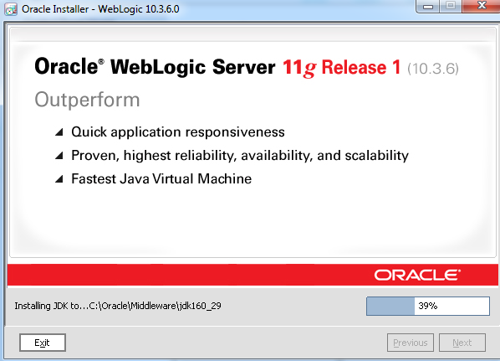
Weblogic 10.3.6

Slide 12
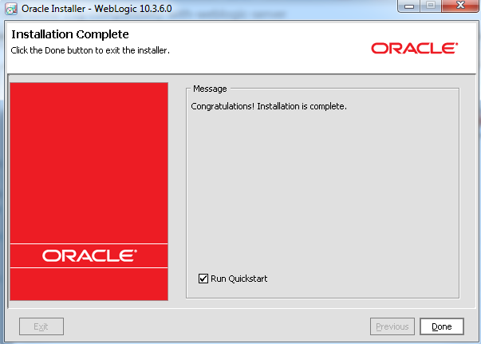
Weblogic 10.3.6

Slide 13
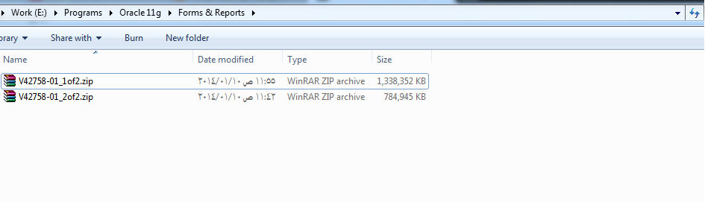
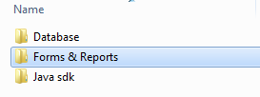
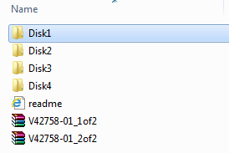
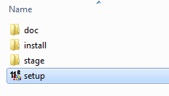
Oracle Forms & Reports 11g Installation
Now Install Forms & Reports From your Oracle 11g Source
Extract

Slide 14
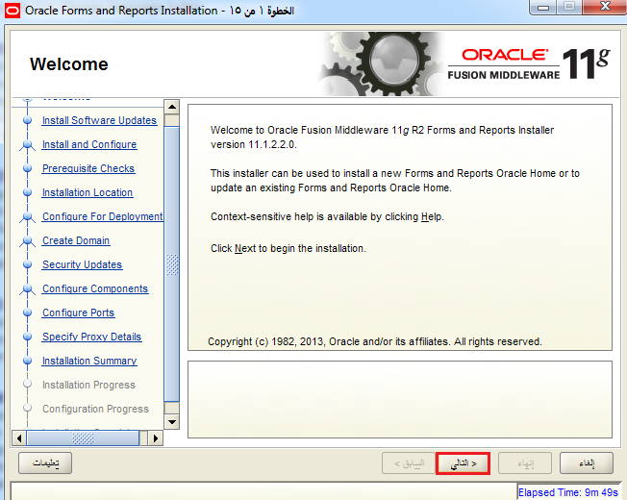
Oracle Forms & Reports 11g Installation

Slide 15
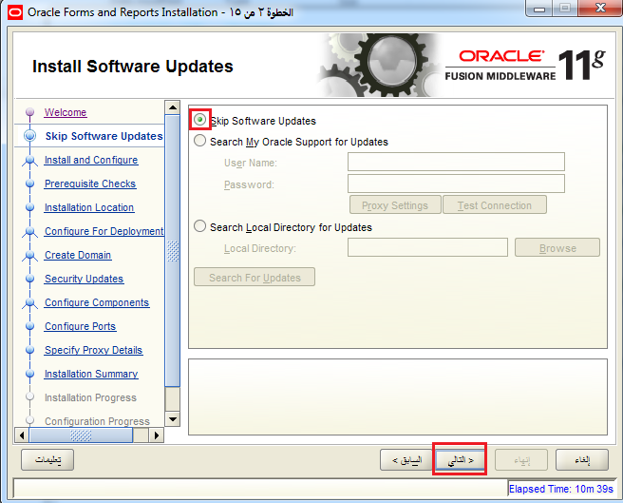
Oracle Forms & Reports 11g Installation

Slide 16
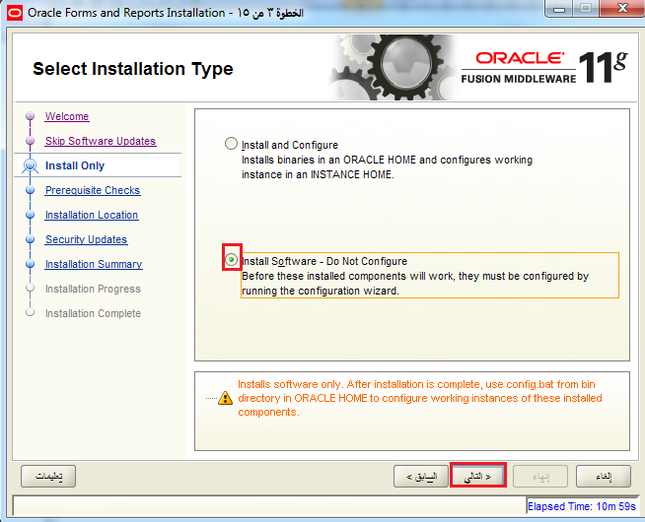
Oracle Forms & Reports 11g Installation

Slide 17
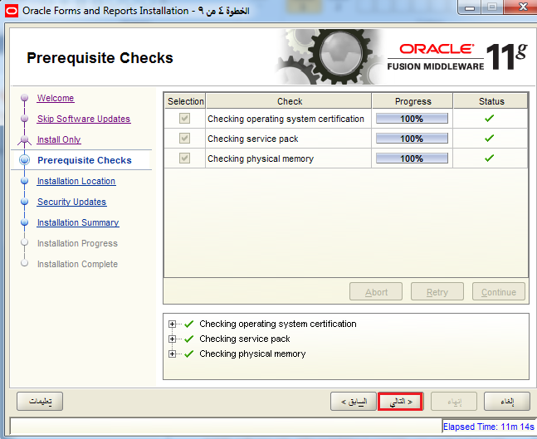
Oracle Forms & Reports 11g Installation

Slide 18
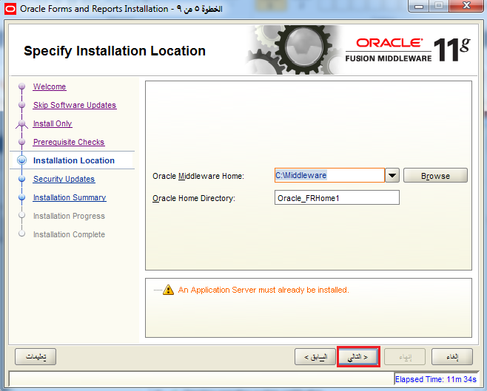
Oracle Forms & Reports 11g Installation

Slide 19
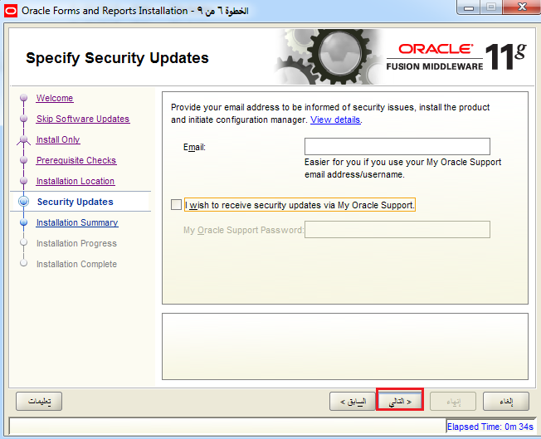
Oracle Forms & Reports 11g Installation

Slide 20
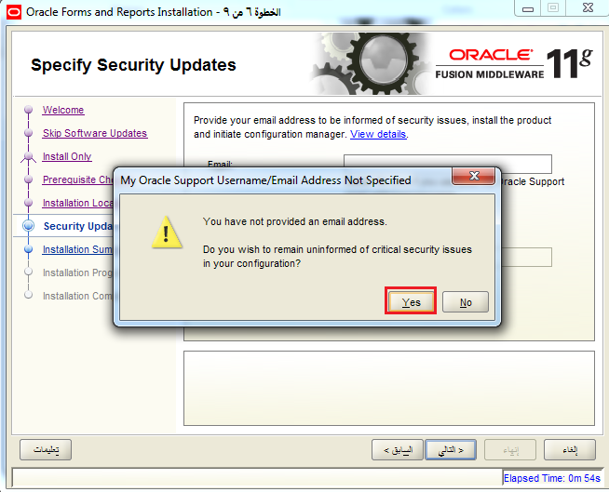
Oracle Forms & Reports 11g Installation

Slide 21
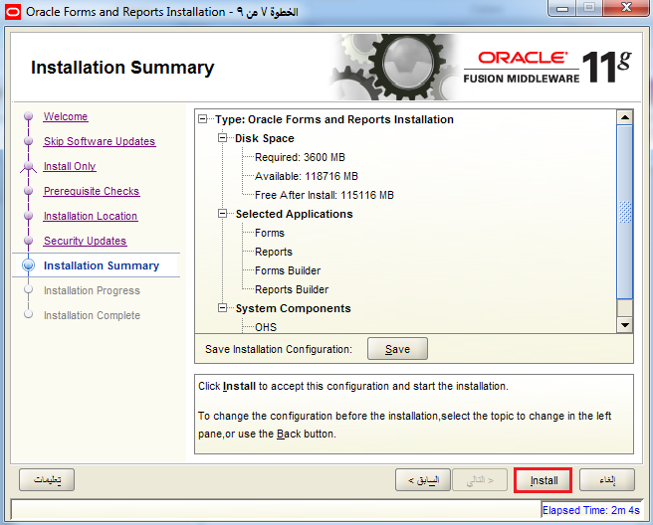
Oracle Forms & Reports 11g Installation

Slide 22
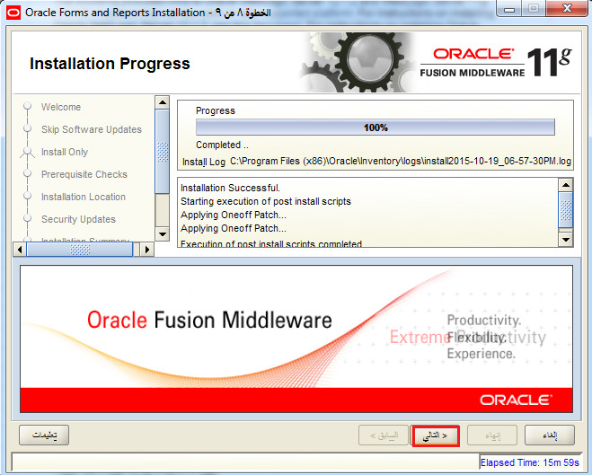
Oracle Forms & Reports 11g Installation

Slide 23
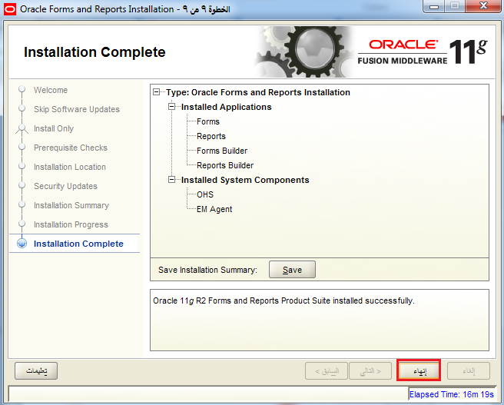
Oracle Forms & Reports 11g Installation

Slide 24
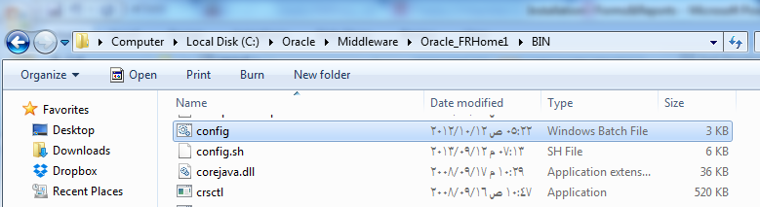
Configure For Development
Open Config file in this path

Slide 25
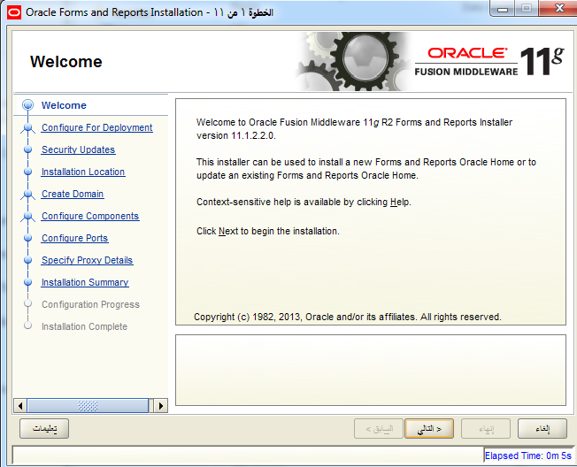
Configure For Development

Slide 26
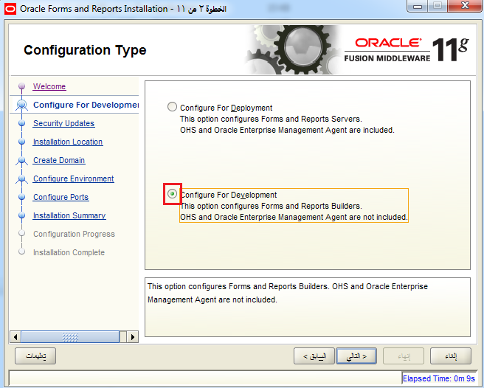
Configure For Development

Slide 27
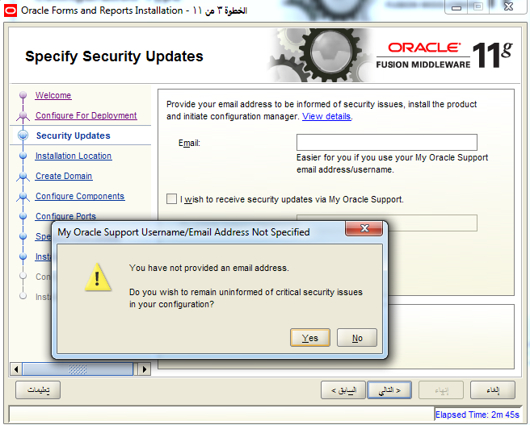
Configure For Development

Slide 28
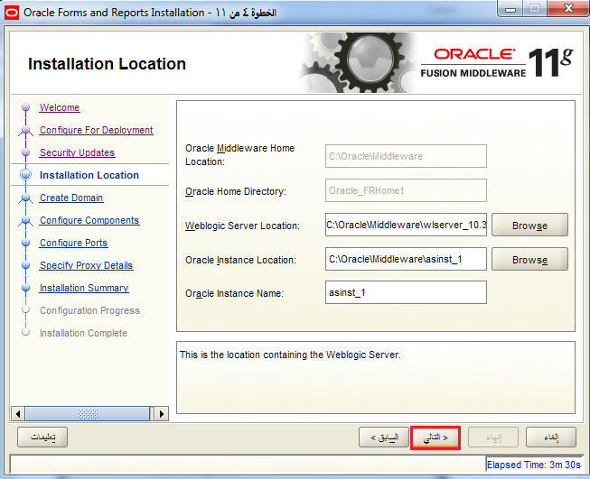
Configure For Development

Slide 29
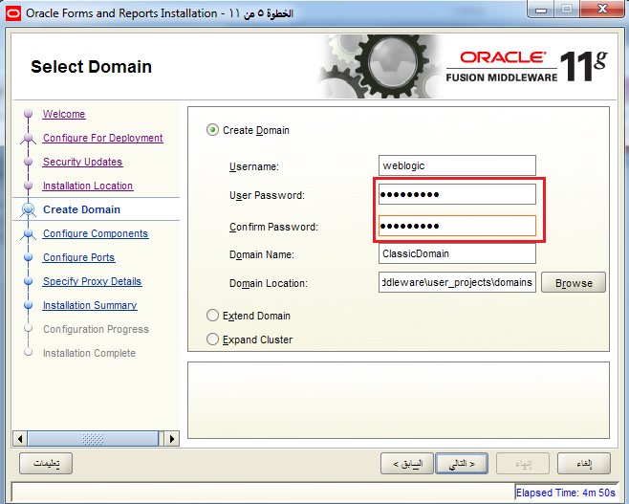
Configure For Development
Set Password As Administrator1

Slide 30
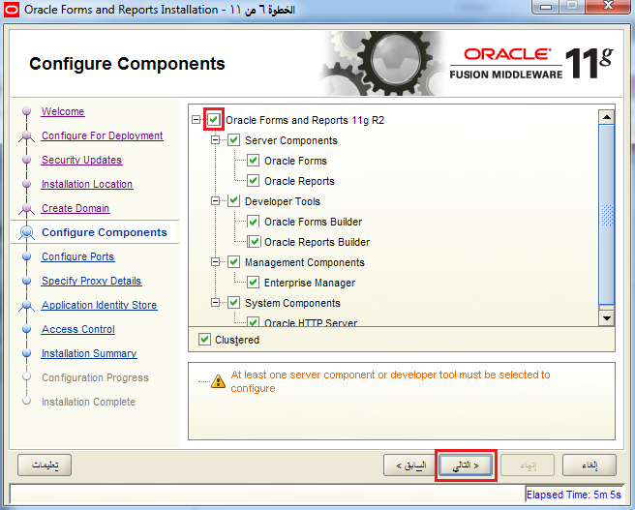
Configure For Development

Slide 31
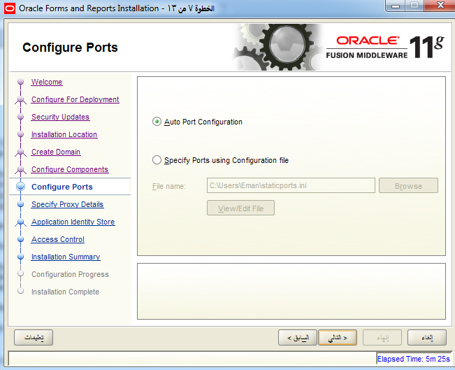
Configure For Development

Slide 32
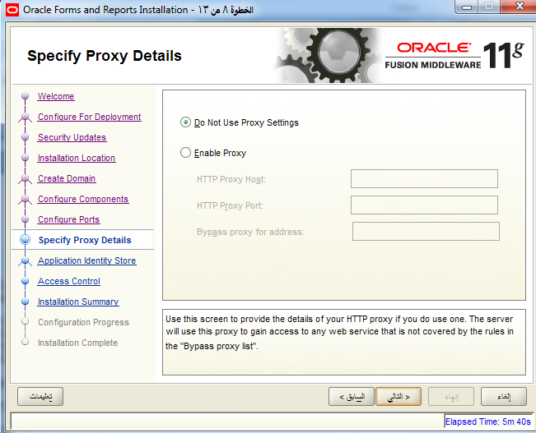
Configure For Development

Slide 33
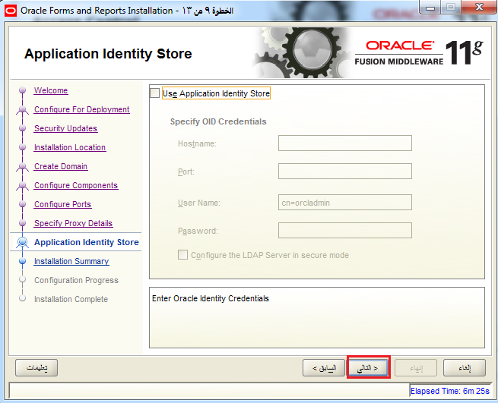
Configure For Development

Slide 34
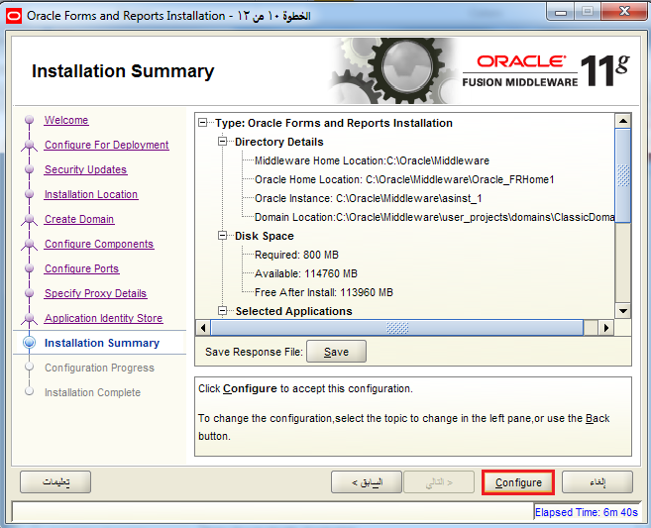
Configure For Development

Slide 35
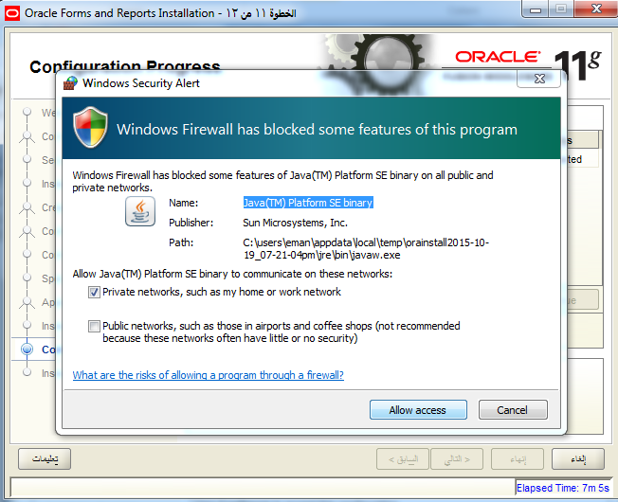
Configure For Development

Slide 36
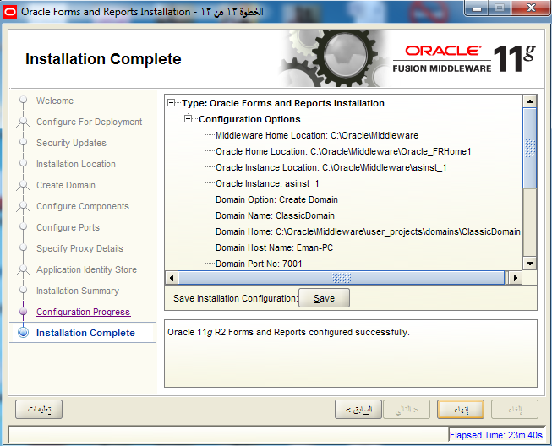
Configure For Development

Slide 37
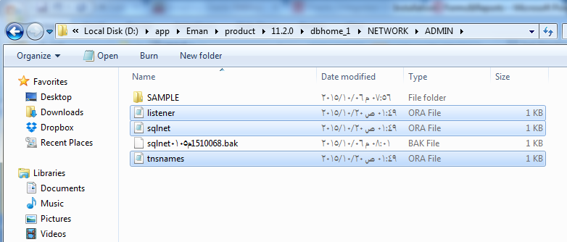
Last Required Steps
Copy the following files:

Slide 38
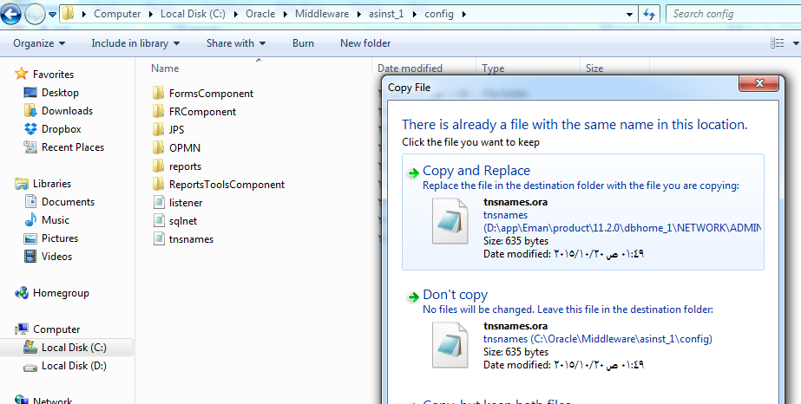
Last Required Steps
Paste them here

Slide 39
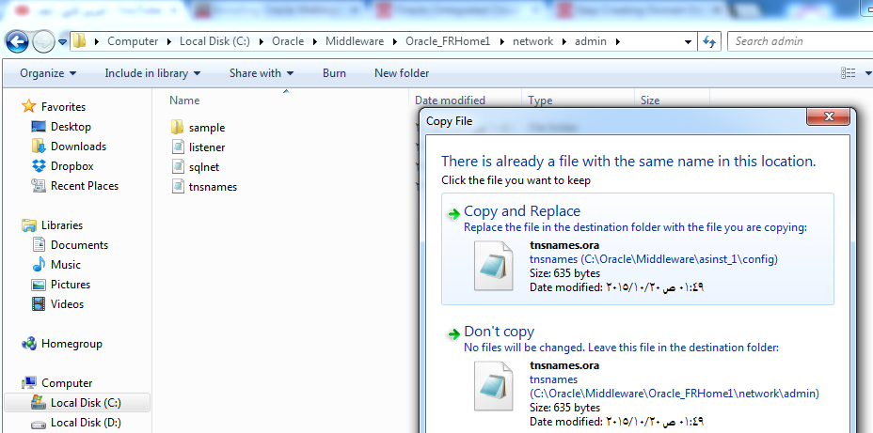
Last Required Steps
Also Paste them here

Slide 40
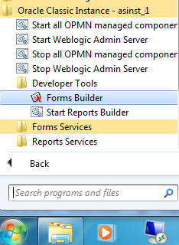
Last Required Steps
Open Forms Builder

Slide 41
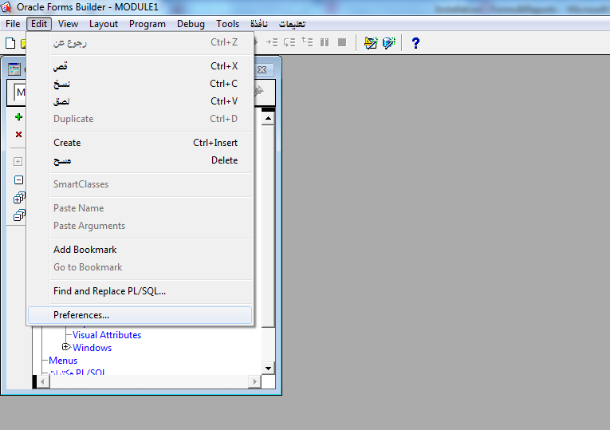
Last Required Steps

Slide 42
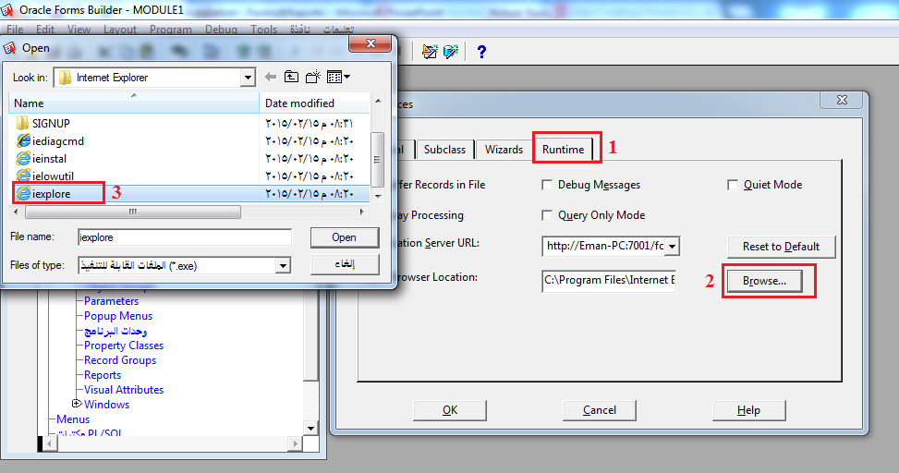
Last Required Steps

Slide 43
Please Don’t
If there is any problem appeared in the setup:
Don’t uninstall the current instance
Don’t try to install another instance
Just contact Your TA

